Slide 1
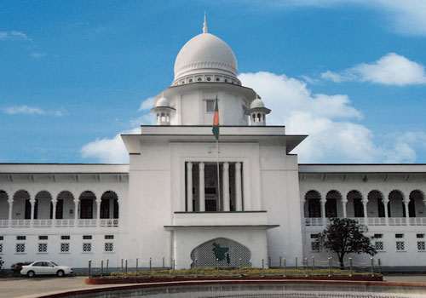
Management of
Judicial System
Sequence, Activity & State Diagram
Chowdhury Md Rakin Haider, 1005009
Shakil Ahmed, 1005014
Md Touhiduzzaman, 1005018
Shohan Al Jannat, 1005023
Tanzeer Hossain, 1005029
CSE , BUET

Slide 2
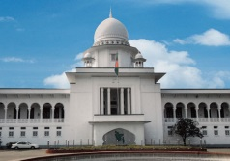
Outline
Subsystems
Respective Use-cases
According to each use case
Activity Diagram
Sequence Diagram
Respective State Diagrams

Slide 3
Subsystems
Police Station
Magistrate Office
Case Filing
CMM Court
Cause List Generation
Copy House
Trial Phase
Magistrate Assignment
Document Collection
Trial Documentation

Slide 4
Subsystem 1: Case Filing
Use Cases:
Case Filing
Forwarding of FIR
Charge Sheet Submission

Slide 5
Subsystem 1: Case Filing
Case Filing Activity Diagram:

Slide 6
Subsystem 1: Case Filing
Case Filing Sequence Diagram:

Slide 7
Subsystem 1: Case Filing
Case Filing State Chart Diagram : Case PS

Slide 8
Subsystem 1: Case Filing
Case Filing State Chart Diagram : FIR Form

Slide 9
Subsystem 1: Case Filing
Forwarding FIR Activity Diagram:

Slide 10
Subsystem 1: Case Filing
Forwarding FIR Sequence Diagram:

Slide 11
Subsystem 1: Case Filing
Forwarding FIR State Diagram: Case PS

Slide 12
Subsystem 1: Case Filing
Forwarding FIR State Diagram: Case Court

Slide 13
Subsystem 1: Case Filing
Charge Sheet Submission Activity Diagram:

Slide 14
Subsystem 1: Case Filing
Charge Sheet Submission Sequence Diagram:

Slide 15
Subsystem 1: Case Filing
Charge Sheet Submission State Diagram: CasePS

Slide 16
Subsystem 2: Cause List Generation
Use Cases:
Case List Sending
Cause List Generation

Slide 17
Subsystem 2: Cause List Generation
Case List Sending Activity Diagram:

Slide 18
Subsystem 2: Cause List Generation
Case List Sending Sequence Diagram:

Slide 19
Subsystem 2: Cause List Generation
Cause List Generation Activity Diagram:

Slide 20
Subsystem 2: Cause List Generation
Cause List Generation Sequence Diagram:

Slide 21
Subsystem 2: Cause List Generation
Cause List Generation State Diagram: Cause List

Slide 22
Subsystem 3: Magistrate Assignment
Use Cases:
Case Reception
Assign & Notify Magistrate

Slide 23
Subsystem 3: Magistrate Assignment
Assign & Notify Magistrate Activity Diagram:

Slide 24
Subsystem 3: Magistrate Assignment
Assign & Notify Magistrate Sequence Diagram:

Slide 25
Subsystem 3: Magistrate Assignment
Assign & Notify Magistrate State Diagram: Court List

Slide 26
Subsystem 3: Magistrate Assignment
Assign & Notify Magistrate State Diagram: Magistrate

Slide 27
Subsystem 4: Document Collection
Use Cases:
Document Sending To Comparer
Document Comparison
Notes:
OC may be omited here

Slide 28
Subsystem 4: Document Collection
Doc. Sending To Comparer Activity Diagram:

Slide 29
Subsystem 4: Document Collection
Doc. Sending To Comparer Sequence Diagram:

Slide 30
Subsystem 4: Document Collection
Document Comparison Activity Diagram:

Slide 31
Subsystem 4: Document Collection
Document Comparison Sequence Diagram:

Slide 32
Subsystem 5: Trial Documentation
Use Cases:
Judgment Documentation

Slide 33
Subsystem 5: Trial Documentation
Judgment Documentation Activity Diagram:

Slide 34
Subsystem 5: Trial Documentation
Judgment Documentation Sequence Diagram:

Slide 35
Subsystem 5: Trial Documentation
Judgment Documentation State Diagram: Case Court

Slide 36

Thank You
Questions?

Slide 37
Subsystem 3: Magistrate Assignment
Case Reception Sequence Diagram:

